Slide 1
Case of the Month

Slide 2
Clinical presentation
A 10 month old female infant presented with the complaints of seizures since the age of 20 days. The seizures commenced with a staring look, followed by jerky movements of bilateral upper limb and lower limbs, lasting for 10-15 seconds. Subsequently the child used to start crying and this lasted for a brief time, usually 1-2 minutes. Initially, she used to have 1-2 episodes/month; later over the next nine months the frequency increased to 3-4 episodes/ day. There were no signs of precocious puberty. Polydactyly was present in left hand and both feet. Rest of the clinical examination was normal.

Slide 3
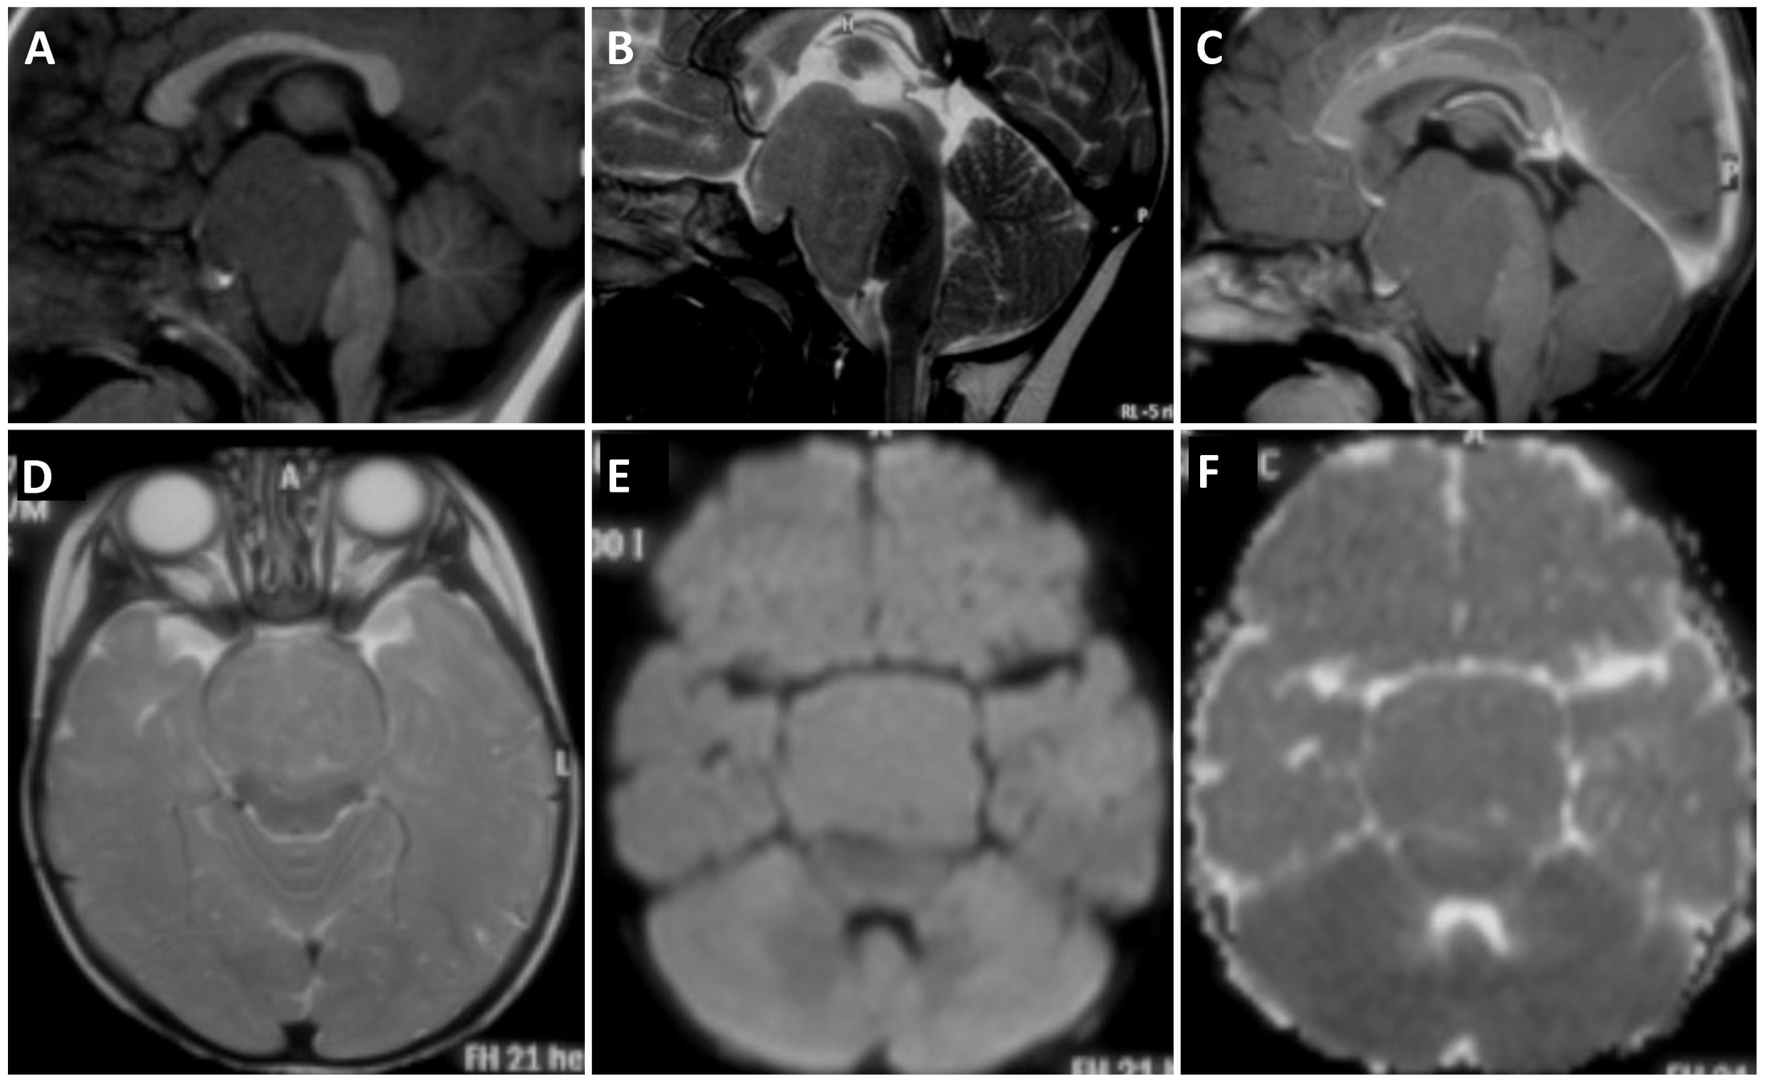

Slide 4
Questions & Comments
1. What is the differential diagnosis?
2. What other investigations are required
3. What is the management plan?
4. What is the expected outcome?

Slide 5
Submit response to
Prof.Malla Bhaskara Rao
Dept. of Neurosurgery
NIMHANS, Bangalore
brmalla@gmail.com

